Slide 1


Fundamentals of Databases (CBIO204)
Spring, 2026
Biobank and Biospecimen Management System
Student: Youssef Hatem - 202000579
PostgreSQL
1

Slide 2
Introduction
What is BioBanker?
Project scope
BioBanker is a database for managing a small research biobank. It keeps donor, consent, collection, sample, storage, aliquot, researcher, test-request, and usage information connected.
• Manage donors and consent
• Record collection events and sample types
• Track freezer/shelf/box storage
• Manage samples and aliquots
• Record researchers and test requests
• Record sample usage
The project focuses on research biospecimen management rather than clinical diagnosis or treatment. The donor data is synthetic.
2

Slide 3
Requirements and Business Rules
Main requirements
Major business rules
• Manage donor and consent information
• Record collection events
• Manage samples, sample types, and storage
• Manage aliquots and remaining volume
• Record researchers and test requests
• Connect samples and requests using an associative table
• Record actual sample usage
• Donor/sample/researcher/aliquot codes are unique
• Foreign keys must reference valid records
• Available volume cannot exceed collected volume
• Aliquot current volume cannot exceed original volume
• One request belongs to one researcher
• Samples and requests have an M:N relationship
• Aliquot over-use is rejected by the trigger
3

Slide 4
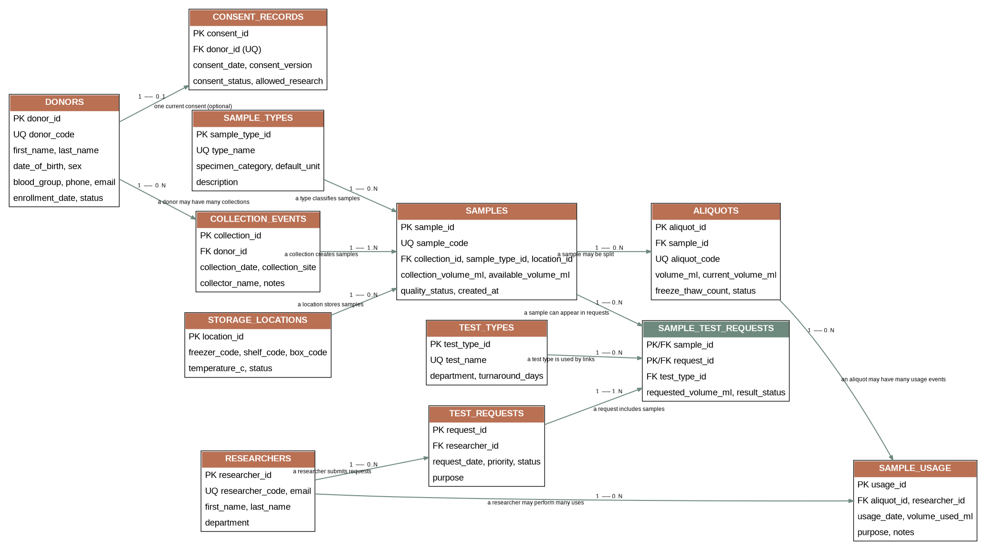
Entity-Relationship Diagram (ERD)
4

Slide 5
Entities and Key Decisions
Entity | Key information | Purpose
DONORS | PK donor_id; UQ donor_code | Donor records
CONSENT_RECORDS | PK consent_id; FK donor_id | Current consent
COLLECTION_EVENTS | PK collection_id; FK donor_id | Collection event
SAMPLE_TYPES | PK sample_type_id; UQ type_name | Sample lookup
STORAGE_LOCATIONS | PK location_id | Physical storage
SAMPLES | PK sample_id; UQ sample_code; 3 FKs | Main biospecimen
ALIQUOTS | PK aliquot_id; UQ aliquot_code; FK sample_id | Sample portions
RESEARCHERS | PK researcher_id; UQ researcher_code | Researchers
TEST_TYPES | PK test_type_id; UQ test_name | Test lookup
TEST_REQUESTS | PK request_id; FK researcher_id | Lab requests
SAMPLE_TEST_REQUESTS | Composite PK/FKs | M:N associative table
SAMPLE_USAGE | PK usage_id; FKs aliquot/researcher | Usage history
5

Slide 6
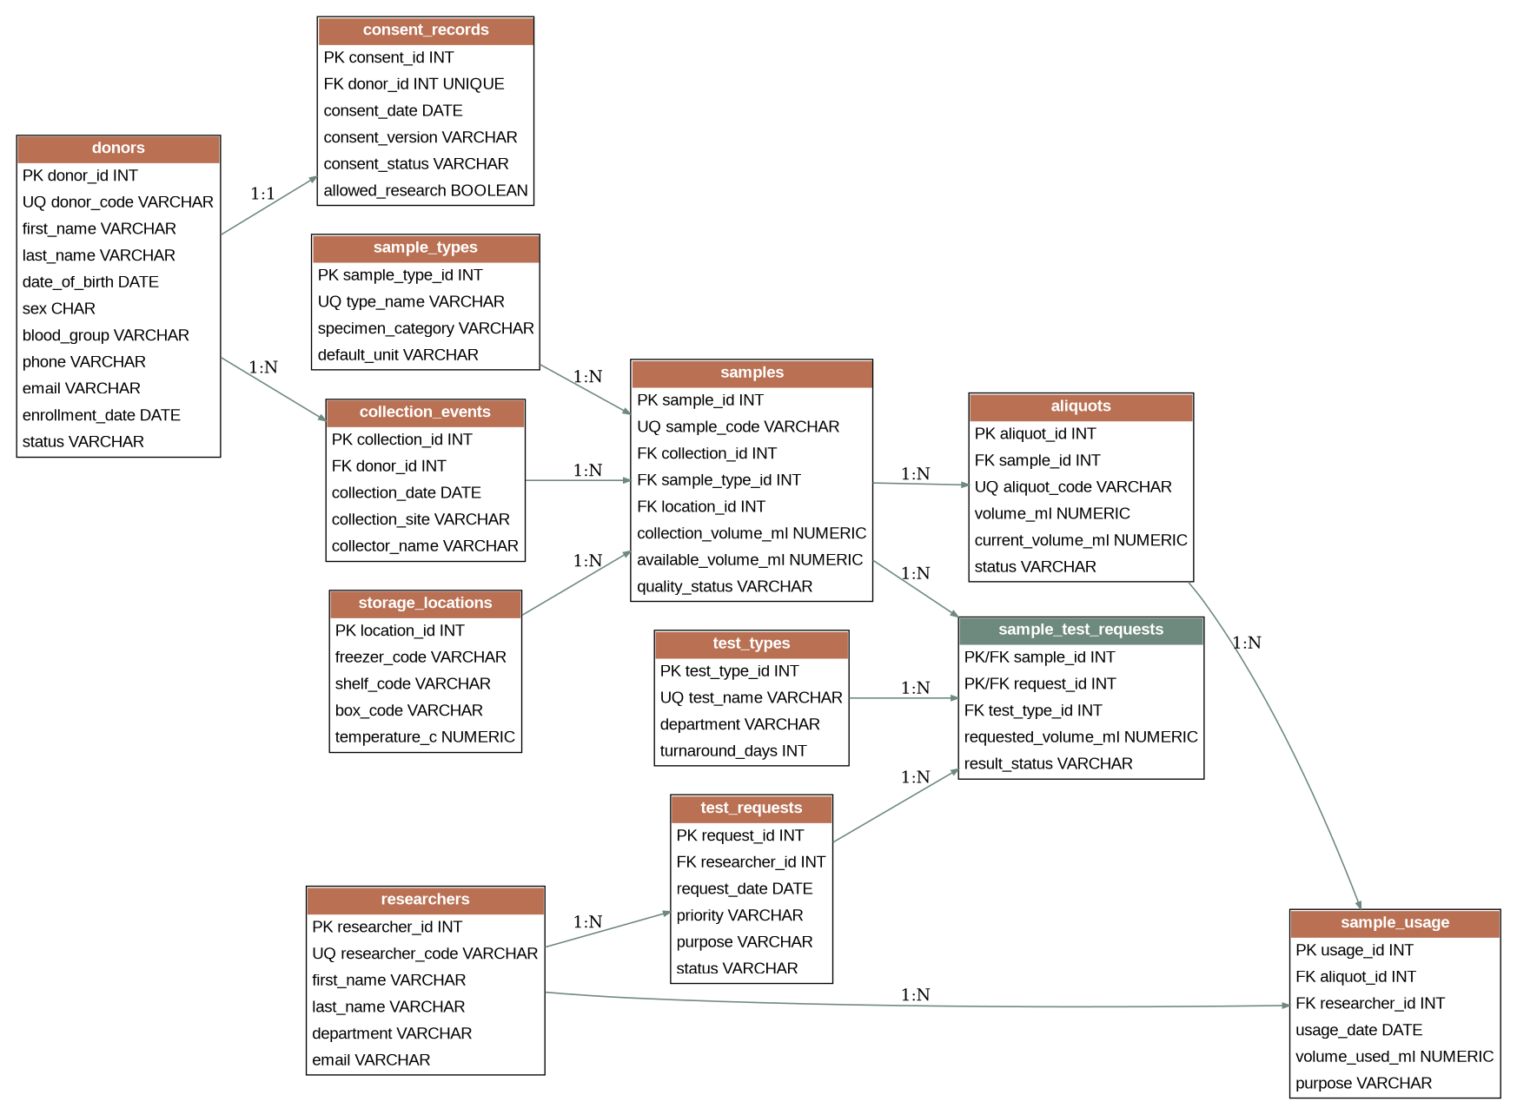
SCHEMA
Key relationships: Donor 1:N Collection Event • Collection Event 1:N Sample • Sample 1:N Aliquot • Researcher 1:N Test Request • Sample N:N Test Request
6

Slide 7
Normalization to 3NF
1NF
2NF
3NF
Atomic values and a primary key for each table.
Non-key attributes depend on the whole key. Relationship-specific data stays in SAMPLE_TEST_REQUESTS.
Related concepts are separated into their own tables, reducing duplication and update problems.
Example: storage details are stored once in STORAGE_LOCATIONS instead of being repeated across many sample records.
7

Slide 8
DDL CODES
DONORS / SAMPLES
M:N + USAGE TABLES
CREATE TABLE donors ( donor_id INTEGER PRIMARY KEY, donor_code VARCHAR(20) UNIQUE, first_name VARCHAR(50), last_name VARCHAR(50), email VARCHAR(120) UNIQUE, status VARCHAR(15) ); CREATE TABLE samples ( sample_id INTEGER PRIMARY KEY, sample_code VARCHAR(25) UNIQUE, collection_id INTEGER REFERENCES collection_events, sample_type_id INTEGER REFERENCES sample_types, location_id INTEGER REFERENCES storage_locations, available_volume_ml NUMERIC, CHECK (available_volume_ml <= collection_volume_ml) );
CREATE TABLE sample_test_requests ( sample_id INTEGER REFERENCES samples, request_id INTEGER REFERENCES test_requests, test_type_id INTEGER REFERENCES test_types, requested_volume_ml NUMERIC, result_status VARCHAR(15), PRIMARY KEY (sample_id, request_id) ); CREATE TABLE sample_usage ( usage_id INTEGER PRIMARY KEY, aliquot_id INTEGER REFERENCES aliquots, researcher_id INTEGER REFERENCES researchers, volume_used_ml NUMERIC CHECK (volume_used_ml > 0) );
8

Slide 9
DML CODES AND TEST DATA
Sample DML
Loaded records
INSERT INTO donors VALUES (1,'D001','Mariam','Hassan', ...); INSERT INTO samples VALUES (1,'SMP001',1,1,1,10,7,'ACCEPTED',...); INSERT INTO test_requests VALUES (1,1,'2025-09-15','HIGH',...,'PENDING');
• Donors — 10
• Researchers — 10
• Consent records — 10
• Collection events — 10
• Storage locations — 10
• Samples — 10
• Aliquots — 12
• Test types — 10
• Test requests — 10
• Sample-test requests — 11
• Sample usage — 10
9

Slide 10
SQL QUERIES
Required operations included
Example JOIN
• Retrieval
• Multi-table JOINs
• Aggregation with COUNT / SUM
• Subqueries
• INSERT
• UPDATE
• DELETE
SELECT s.sample_code, d.donor_code, st.type_name, sl.freezer_code FROM samples s JOIN collection_events ce ON ce.collection_id = s.collection_id JOIN donors d ON d.donor_id = ce.donor_id JOIN sample_types st ON st.sample_type_id = s.sample_type_id JOIN storage_locations sl ON sl.location_id = s.location_id;
10

Slide 11
VIEWS AND ADVANCED DATABASE OBJECT
VIEW 1 — sample_inventory
TRIGGER — manage_aliquot_usage()
Combines sample + donor + sample type + storage information.
Checks the aliquot's remaining volume before use. Valid usage reduces the remaining volume. Over-use is rejected, and deleting a usage record restores the volume.
VIEW 2 — pending_test_requests
Shows pending/in-progress requests, researcher, priority, status, and linked sample count.
11

Slide 12
TEST CASES AND TESTING EVIDENCE
Test | Action | Expected result
T01 | Duplicate donor code | Rejected
T02 | Invalid sample volume | Rejected
T03 | Invalid foreign key | Rejected
T04 | Valid aliquot usage | Volume decreases
T05 | Delete usage record | Volume restored
T06 | Over-use aliquot | Trigger rejects
12

Slide 13
IMPLEMENTATION
The database was implemented using SQL Workbench.
The SQL files were separated by purpose to make the project easier to run and understand.
• create_tables.sql — tables, keys, constraints, indexes
• load_data.sql — project test data
• queries.sql — retrieval, joins, aggregation, subqueries, INSERT/UPDATE/DELETE
• views.sql — two reporting views
• triggers_procedures.sql — trigger and function
• testing.sql — constraint and trigger tests
13

Slide 14
LIMITATIONS AND CONCLUSION
Limitations
Conclusion
• One current consent record per donor
• Synthetic data only
• No user accounts, permissions, audit logs, or backups
• Focus is sample management and research use
• Production use would need more validation and monitoring
BioBanker connects donor enrollment and consent through collection, storage, aliquoting, laboratory requests, and sample use. Separate tables, the associative M:N table, constraints, views, and the trigger make the database practical and easier to maintain.
The project demonstrates the main database operations and design decisions needed for the course.
14

